Slide 1

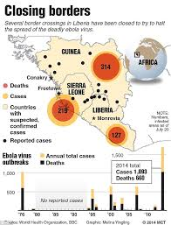

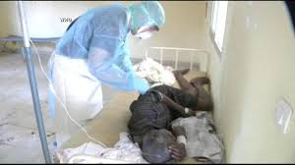
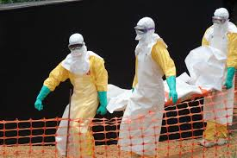
Ebola Virus Disease Preparedness
EVD Preparedness Meeting:
Check List and Dashboard
14-16 January 2015

Slide 2
Outline of the Presentation
The revised checklist
Design of the dashboard
Utility of the dashboard
Discussion and questions

Slide 3
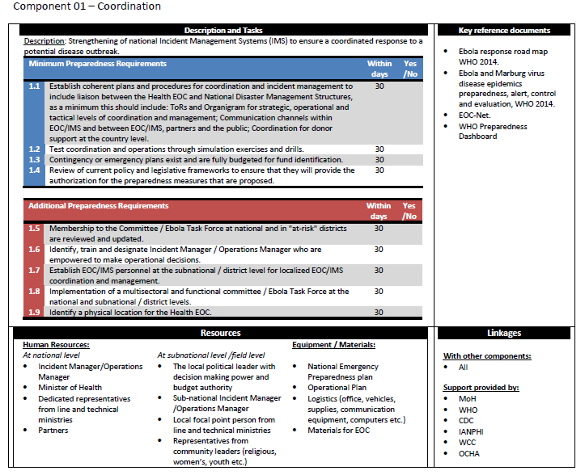
Revised Checklist
Edits made to text based on feedback from PST missions
Categorisation into minimum and addition requirements
Updates to reference materials

Slide 4
Revised Checklist
Addition of Logistics as a separate functional area

Slide 5
What does it do, who is if for?
Tracks aggregates progress on checklist activities

Slide 6
How is it constructed?
Addition of weighting
Country assessment made by the PST
Percentage of completed activities

Slide 7
How is it constructed
Aggregation of minimum and additional activities
30%

Slide 8
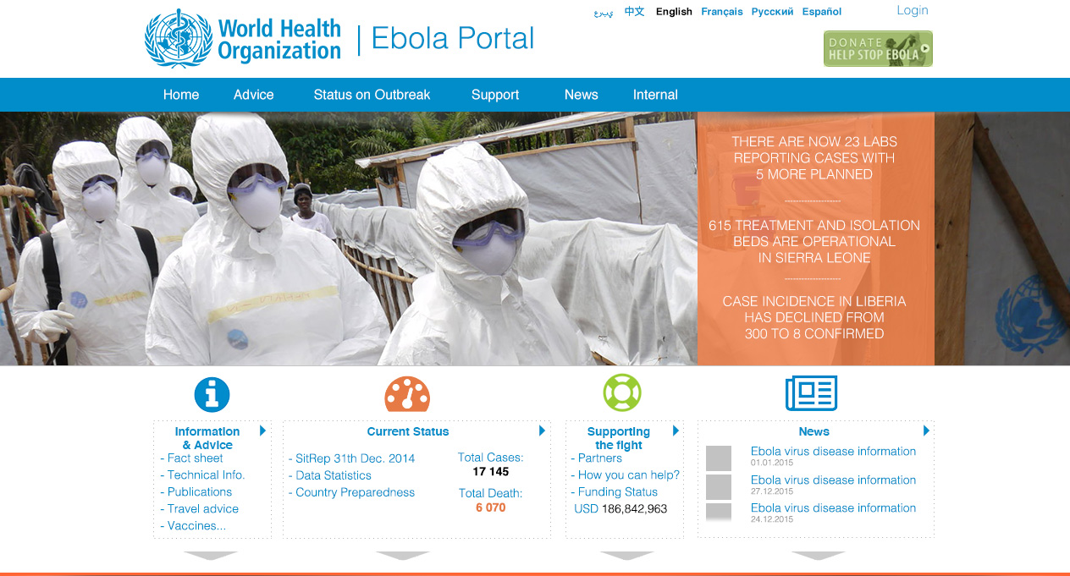
How is it accessed?

Slide 9
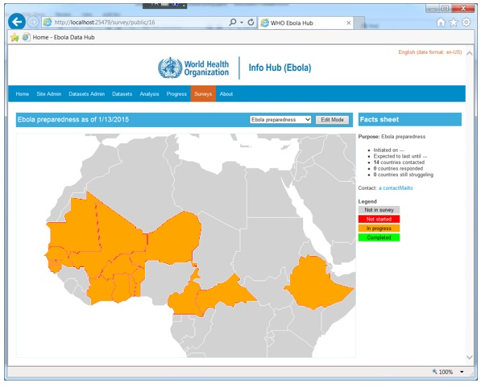
Global Level
Red = Zero percentage completed
Orange = 1-74% completed
Green = 75-100%

Slide 10
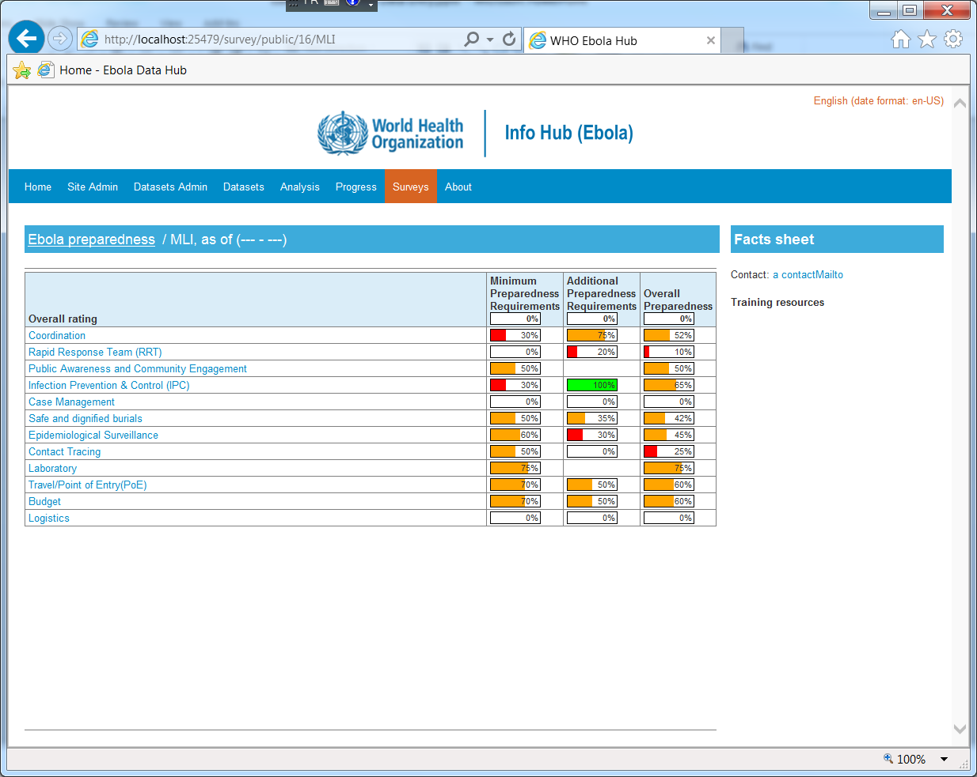
Country level by 11 Functional areas

Slide 11
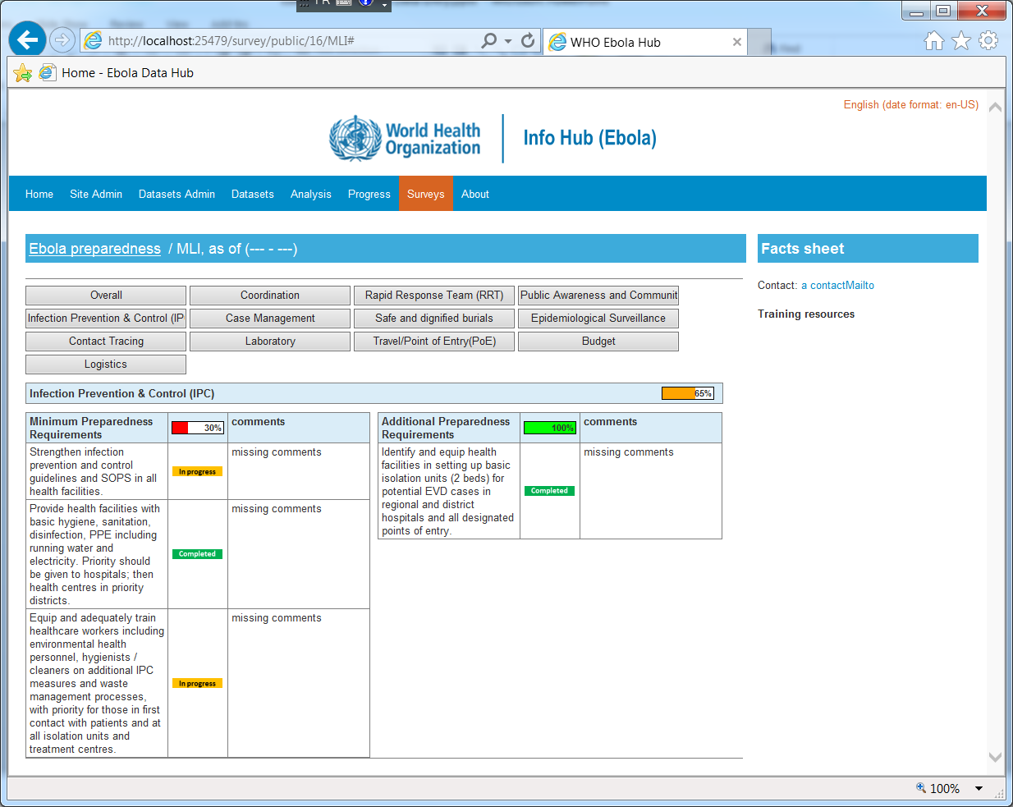
Country level by activities
Reporting
Quick navigation
On going status updates
Linkages to tools, guidelines, training packages etc…

Slide 12
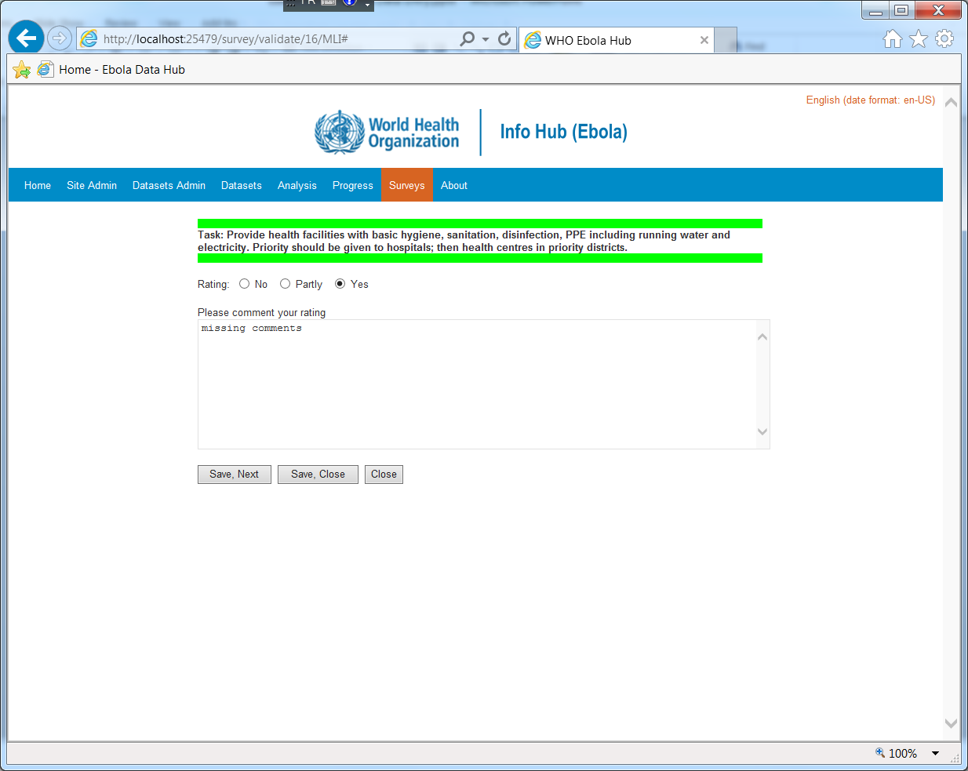
Dashboard Updates
Check list activity
Activity status
Ongoing updates and document uploads

Slide 13

Questions

